Slide 1
KS2 ASSEMBLY

Slide 2
This is Todd – what job does he do?
He has to be at work before 7 every morning
He needs to follow instructions carefully
He needs to know about germs and common illnesses
People trust him with their most precious things
He often has to clean up toys and games
He’s a worker in a nursery

Slide 3
This is Maria What job does she do?
She had to go to university for 7 years
She works with technicians & scientists
She can be asked to work at any time of the day and any day of the week
She works in a hospital
She is a doctor

Slide 4
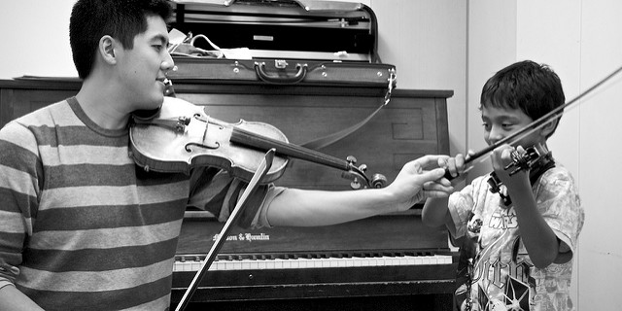
This is Steven what job does he do?
He plays a violin
Steven works in a team
He often organises workshops
He is a music teacher

Slide 5
This is xxx what job does (s)he do?
Clue
Clue
Clue
Clue
Clue
Clue

Slide 6
This is xxx what job does (s)he do?
Clue
Clue
Clue
Clue
Clue
Clue

Slide 7
This is xxx what job does (s)he do?
Clue
Clue
Clue
Clue
Clue
Clue

Slide 8
There are lots of different jobs
Talk to your family and friends about jobs they do – Do they enjoy their work?
What would you like to do when you grow up?
Find 5 jobs you’ve never heard of before

