Slide 1


Slide 2


Slide 3


Slide 4


Slide 5

Mrs Shaw
Business Champion
Engaging with Employers
Mr Millar
Career Coordinator

Slide 6


Slide 7


Slide 8


Slide 9
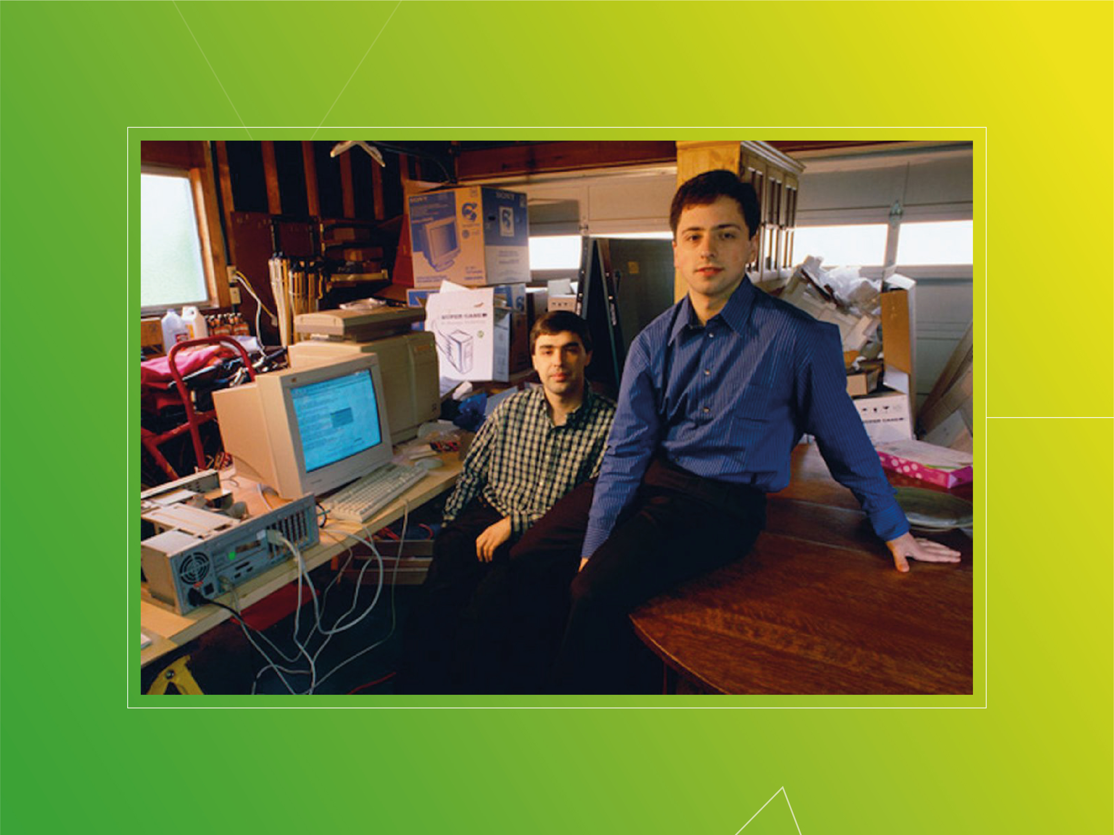

Slide 10
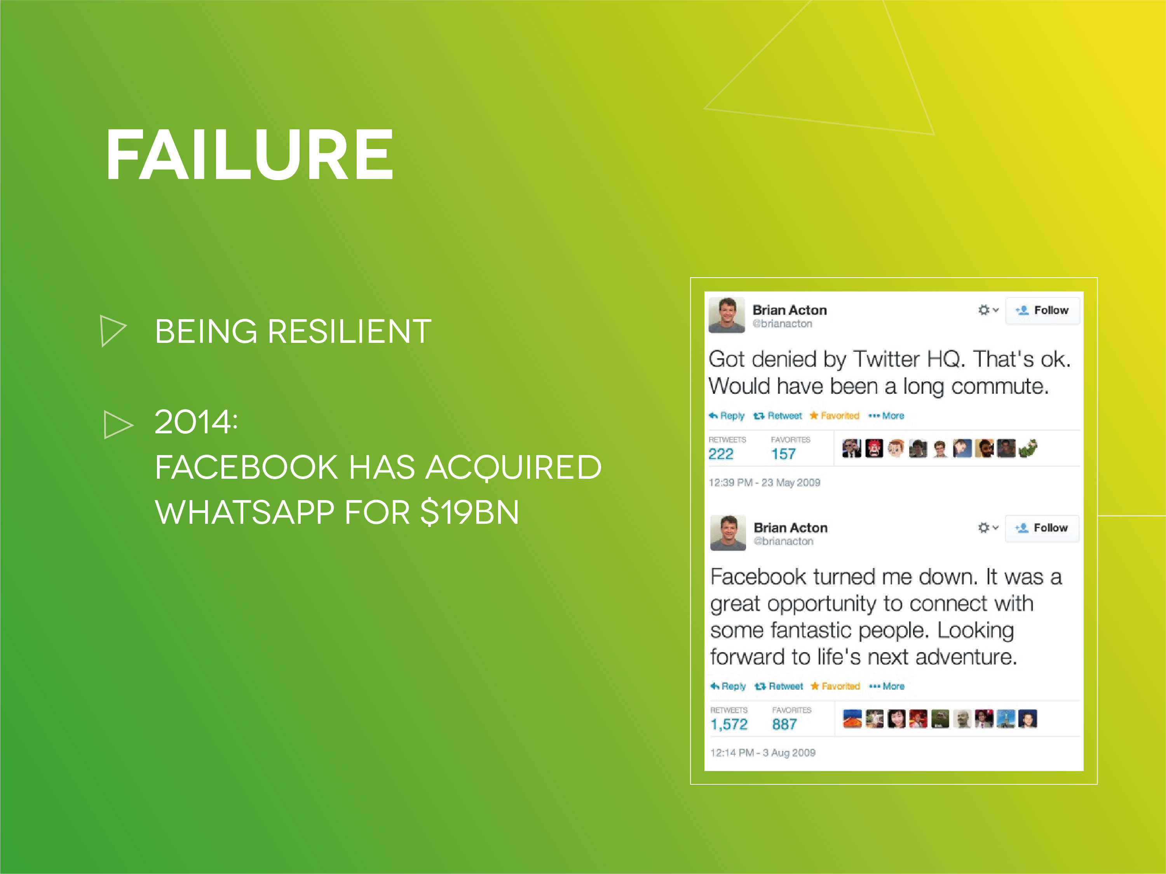

Slide 11


