Slide 1
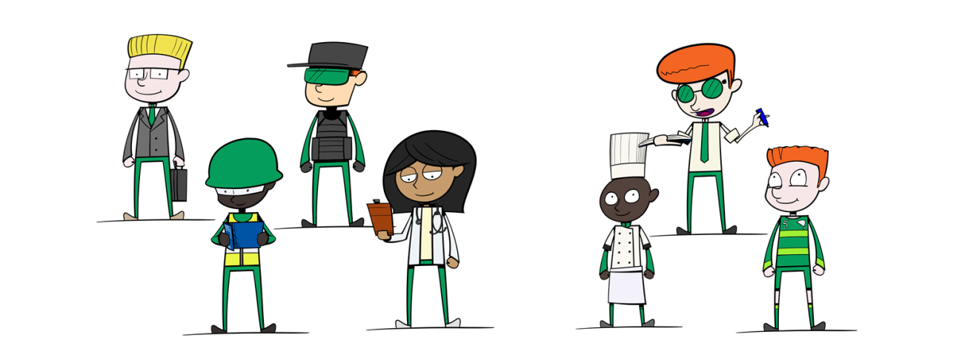
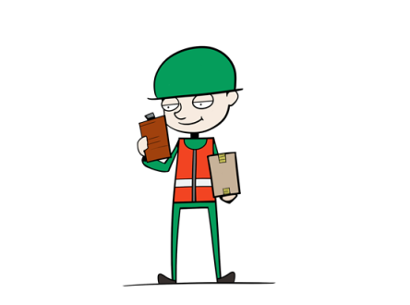
National Careers Week 2022
Jobs People Do

Slide 2
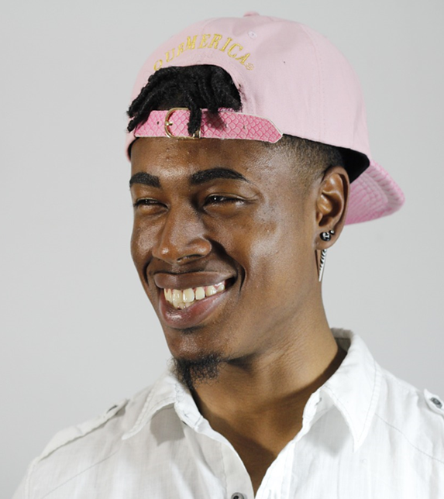
What does Joe do?
He has to be at work before 7 every morning
He needs to follow instructions carefully
He needs to know about germs and common illnesses
People trust him with their most precious things
He often has to clean up toys and games
He’s a worker in a nursery

Slide 3
What does Maria do?
She had to go to university for 7 years
She works with technicians & scientists
She can be asked to work at any time of the day and any day of the week
She works in a hospital
She is a doctor

Slide 4
What does Neil do?
Without my uniform, I would die
My job is very dangerous and involves travelling a long way
I might be away from home for months at a time
My job is very difficult and requires a lot of training. Only a few people will ever be good enough
He is an Astronaut

Slide 5
What does Abby do?
Without me, the internet would not work
I connect computer systems together, and make sure they work
I might be working virtually on devices all across the world
I need to know what an IP address is
I’m a network engineer

Slide 6
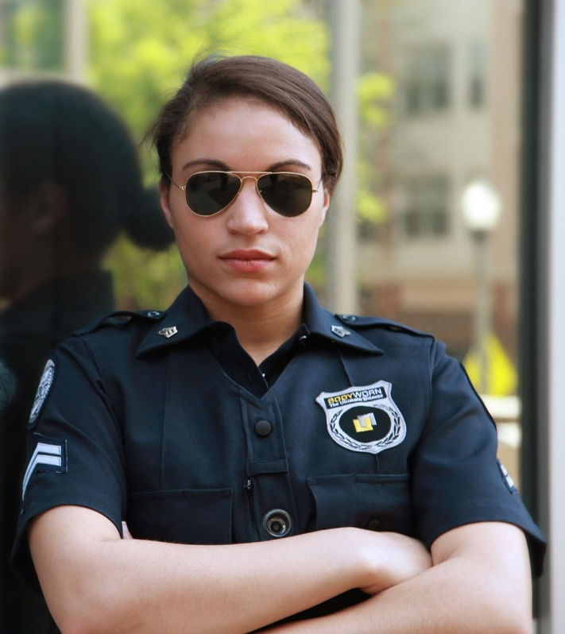
What does Lori do?
I wear a uniform to do my job
I help people
I investigate
I catch criminals
I’m a police officer

Slide 7
What does x do?
Point 1
Point 2
Point 3
Point 4
Point 5
Copy and paste this slide and modify as required.

Slide 8
Review
Remember, all the jobs you have just seen need lots of personal skills
It’s not all about exams and certificates, although they help a lot!
Ask your parents about what skills they need for their job
What’s your dream job? Why?

