Slide 1
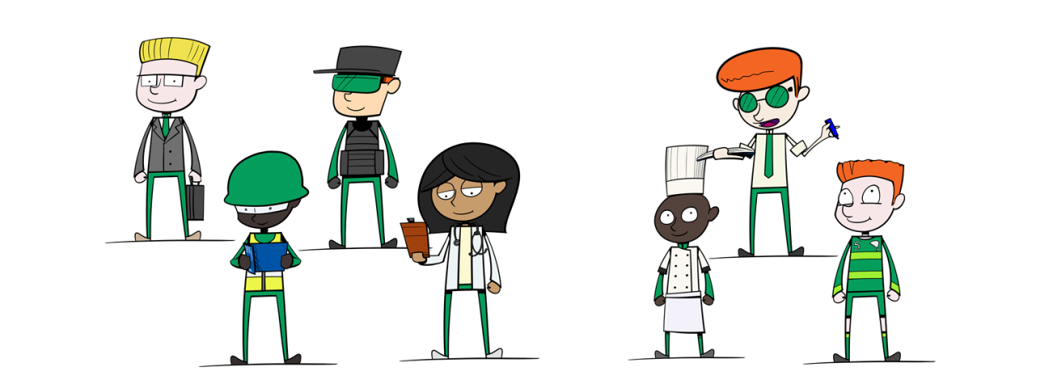
National Careers Week 2022
The Future Of Work

Slide 2
How many jobs can you think of?
Pair with a friend and keep track of how many

Slide 3
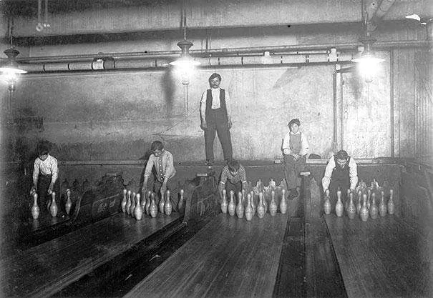
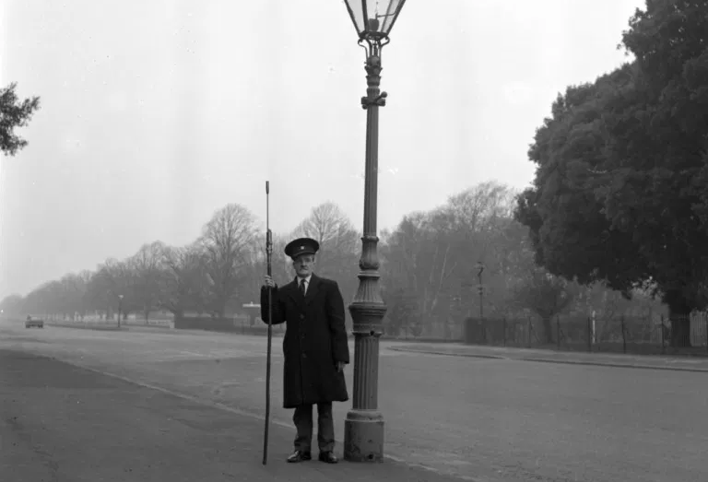
Did you think of any of these?
Pinsetter
Lamp Lighter

Slide 4
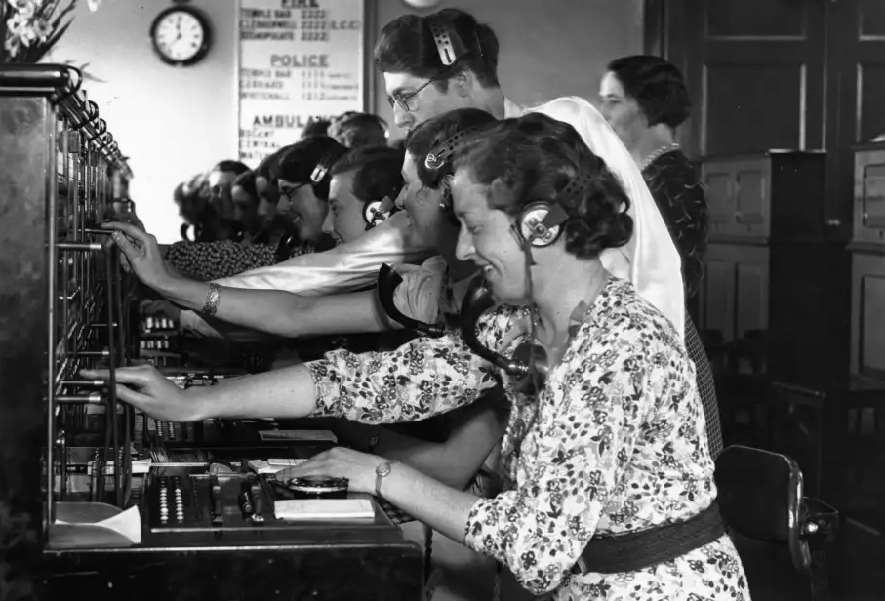
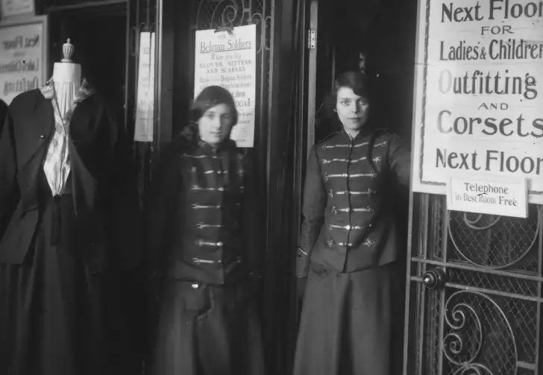
Did you think of any of these?
Switchboard Operator
Elevator Operator

Slide 5
Jobs That Don’t Exist
Jobs being replaced with technology is not a new thing
Many jobs have disappeared over the last hundred years due to technology
Jobs that people do now will disappear in your lifetime

Slide 6
Jobs At Risk
Reprographics Assistants
Farm Workers
Warehouse Operatives
Shelf Stackers
Factory Operatives
Telephone Sales
Frontline IT Support
Technical Support
Legal Secretaries

Slide 7
Jobs For The Future
AI & Robotics Engineer
Information security analysts
Teachers
Electricians
Drone Pilot
Plumbers
Blockchain Developer
Renewable Energy Related Occupations
Truck Drivers
Registered Nurses
Carpenters
Software Developers
CGI Artist
Doctors
Source: https://www.businessinsider.com/best-jobs-future-growth-2019-3?r=US&IR=T

Slide 8
Review
Investigate jobs of the future
The demand for jobs will change as technology advances, and the needs of the population change

