Slide 1
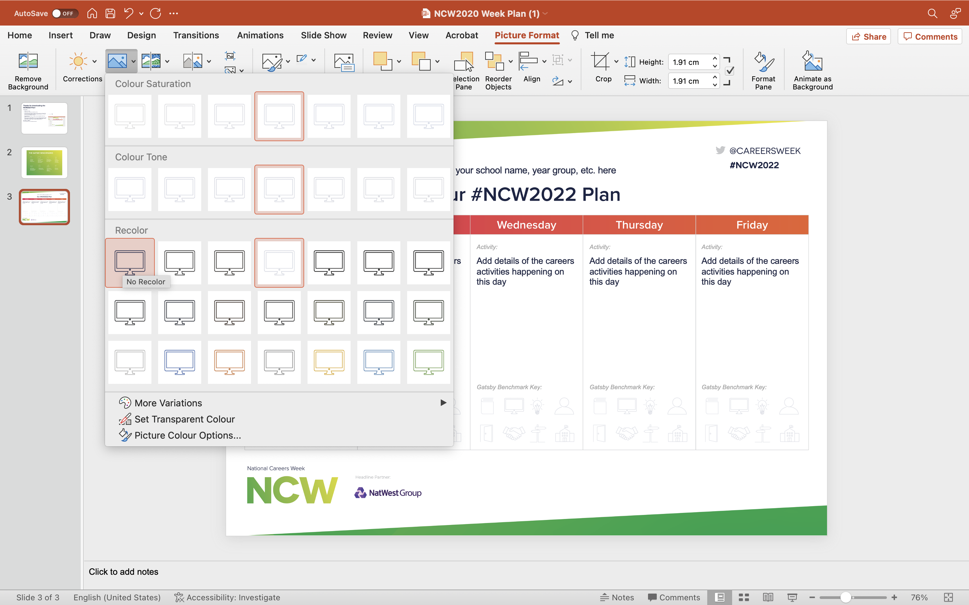
Thanks for downloading the NCW2024 Plan!
How to use this:
Add your school name
Add a description of the career activities for each day
Highlight the benchmark icons that are applicable to the day’s activities. You can do this by selecting the icons and under the ‘picture format’ tab, select the colour > no recolour option and you should see that icon stand out.
If you can’t fit all your activities on one plan, you can create copies for individual year groups, classes, etc!
When you’ve got a completed plan you can print these out to put around school, or export as an image file to share digitally! Don’t forget to tag National Careers Week in on social media as we love seeing all the great work you are doing for #NCW2023!
Exporting as an image file
Go to File > Export and select JPEG as the file format.

Slide 3
Add your school name, year group, etc. here
Add details of the careers activities happening on this day
Add details of the careers activities happening on this day
Add details of the careers activities happening on this day
Add details of the careers activities happening on this day
Add details of the careers activities happening on this day

